Slide 1
PROJECT TITLE: HEART DISEASE PREDICTION
PIP104 PROFESSIONAL PRACTICE-II
VIVA-VOCE
Batch Number: CSD6
Under the Supervision of,
Dr. V Chandrasekar (Project Guide)
Professor
School of Computer Science &Engineering Presidency University
Dr.K Susheel Kumar (Project Reviewer)
Asst.Professor
School of Computer Science &Engineering Presidency University
Roll Number | Student Name
20201CSD0067 | Katakaraju Vaahini
20201CSD0080 | Pujari Suresh
20201CSD0081 | Korrapati Praneeth Kumar Gowd
20201CSD0120 | Duttala N Sughanditha Reddy

Slide 2
Introduction
Due to busy schedule as well as routine assignments peoples are facing severe stress and anxiety. More over some other peoples are addicted with chronic habitual behavior, like consumption of Cigars and Gutka, those peoples are suffering from chronic diseases like, heart diseases, cancer, Liver problems, Kidney failures etc.
In the present scenario each humans are so exceptional in his individual features and manners, but even though every humans may have different pulse rate as well as blood pressure ratings. Based on the history and generic evaluation of medical practitioners and researchers believed that, a healthy humans pulse rate is varied in between of 60 to 100 bpm and BP is varied in between of 120/80 to 140/90 (mm Hg), and these readings are proved by medical practitioners.
So we proposed a system with the help of machine learning techniques and algorithms like KNN, SVC, Random Forest and Naïve Bayes to predict Heart Disease based on different parameters entered by the user in the front end.

Slide 3
Literature Review
P. Sujatha and K. Mahalakshmi :
In this research paper, the presence of heart disease is predicted by employing Decision Tree, Naïve Bayes, Random Forest, Support Vector Machine, K-Nearest Neighbor and logistic Regression algorithms. The performance of the algorithms was analyzed using parameters such as Accuracy, Precision, AUC and F1-score. From the experimental result, it is found that the Random Forest is more accurate for predicting the heart disease with accuracy of 83.52% compared with other supervised machine learning algorithms. The F1- Score, AUC and precision score of Random forest classifiers are 84.21%, 88.24% and 88.89% respectively.[1]
P. S. Kohli and S. Arora :
In this paper, we apply different classification algorithms, each with its own advantage on three separate databases of disease (Heart, Breast cancer, Diabetes) available in UCI repository for disease prediction. The feature selection for each dataset was accomplished by backward modeling using the p-value test. The results of the study strengthen the idea of the application of machine learning in early detection of diseases.[2]

Slide 4
Literature Review
Ed-Daoudy and K. Maalmi :
This paper propose a real time heart disease prediction system based on apache Spark which stand as a strong large scale distributed computing platform that can be used successfully for streaming data event against machine learning through in-memory computations. The system consists of two main sub parts, namely streaming processing and data storage and visualization. The first uses Spark ML lib with Spark streaming and applies classification model on data events to predict heart disease. The seconds uses Apache Cassandra for storing the large volume of generated data.[3]
Lakshmanarao, A. Srisaila and T. S. R. Kiran :
In this paper, they proposed a novel machine learning model for heart disease prediction. The proposed method was tested on two different datasets from Kaggle and UCI. We applied sampling techniques to the unbalanced dataset and feature selection techniques are used to find the best features. Later several classifier models were applied and achieved good accuracy with ensemble classifier. The experimentations on two datasets shown that the proposed model is effective for heart disease prediction. Python was used for all implementations.[4]

Slide 5
Literature Review
Erdoğan and S. Güney:
Investigated heart disease, a significant cause of patient mortality. The complexity in diagnosing these conditions arises due to symptoms overlapping with other ailments such as chest pain, shortness of breath, palpitations, and nausea, causing diagnostic challenges. Their study focused on applying machine learning algorithms for heart disease diagnosis, emphasizing the importance of weighing patient data to improve diagnostic accuracy. They also introduced a method to determine weight coefficients. Their proposed approach achieved a success rate of 86.90%, analyzing 3 unique patient-derived features.[5]
D. Veeraiah and S. Farzana:
This work uses machine learning techniques such Gaussian Naïve Bayes, Random Forest, K-Nearest Neighbor, and Support Vector Machine to construct a Heart Disease Prediction system, focusing on the critical topic of heart disease. Thirteen features are used by the framework, such as age, gender, blood pressure, cholesterol, and obesity, among others. Efficient healthcare decision-making is facilitated by the user-friendly solution, which comprises dataset uploading, algorithm selection, accuracy prediction, and model development. [6]

Slide 6
Research Gaps Identified
Data Diversity and Representation: Structured clinical data is necessary for many machine learning models that predict heart disease. Utilizing heterogeneous datasets that include unstructured data such as genetic information, imaging, patient histories, and socioeconomic factors is lacking. Combining these various data sources could improve forecast precision and offer a more thorough knowledge of the risk factors for heart disease.
Precision Medicine and Personalization: Personalized risk prediction models that take into account individual variations in genetics, lifestyle, and environmental factors are lacking. Preventive measures could be greatly enhanced by creating models that can offer individualized risk assessments and treatment recommendations based on the specific needs of each patient.

Slide 7
Research Gaps Identified
Validation and External Generalizability: Although a lot of predictive models perform well in certain datasets, their effectiveness may differ when applied to a variety of patient populations or healthcare environments. To guarantee the generalizability and reliability of these models, strong validation and external validation studies are required.
Extended Observation and Forecasting of Results: Predictive models frequently concentrate on immediate risk evaluation. The development of models that can predict and track heart disease outcomes over an extended period of time is lacking, which could inform long-term interventions and treatment plans.
By filling in these research gaps, machine learning models for heart disease prediction may become much more accurate, comprehensible, and useful in real-world applications thereby leading to better patient outcomes and care.

Slide 8
Proposed Methodology
Python and machine learning is been used.
The model will be trained using popular Python libraries like Feature Selection, Data Preprocessing, Cross Validation.
The dataset will include various documents labeled with desired information, such as patient’s medical conditions.
The proposed method is a promising approach for extracting medical information from dataset
A system is proposed with the help of machine learning techniques and algorithms like KNN, SVC, Random Forest and Naïve Bayes to predict Heart Disease based on different parameters entered by the user in the front end.

Slide 9
Objectives
The main aim of this project to predict the Heart Disease using machine learning techniques and algorithms like KNN, SVC, Random Forest and Naïve Bayes based on different parameters entered by the user in the front end.

Slide 10
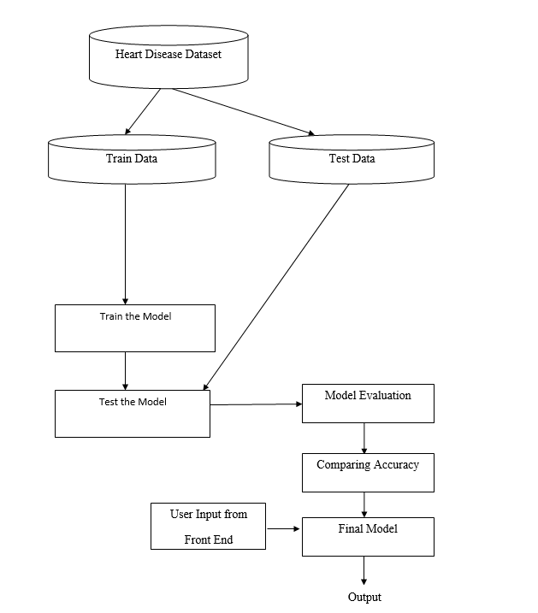
System Design & Implementation

Slide 11
System Design & Implementation
Heart Disease dataset is taken and loaded.
The data is preprocessed to clean the data and understand the dataset.
The data is split as training and testing data.
The model is built using machine learning algorithms like Random Forest Classifier, KNN, SVC, Naïve Bayes
The model is trained with the preprocessed data.
The model is tested and accuracy is calculated for different ML algorithms.
The algorithm with best accuracy is finalized and that model will predict whether the person has the heart disease or not based on user given new data from front end.

Slide 12
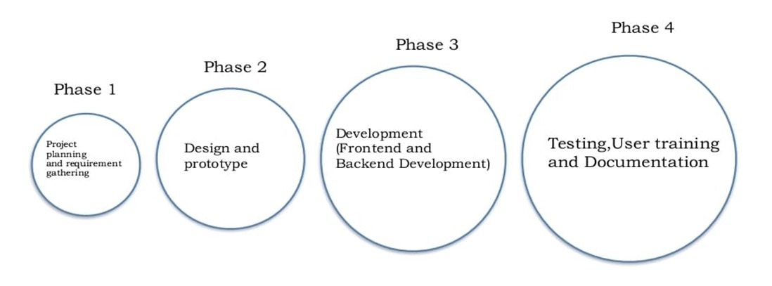
Timeline of Project

Slide 13
Outcomes / Results Obtained
The system with the help of machine learning techniques and algorithms like KNN, SVC ,Random Forest and Naïve Bayes to predict Heart Disease based on different parameters entered by the user in the front end.
Predicting the heart disease based the doctors data with concern with patients
We implemented our project and the system predicts Heart Disease with good accuracy of 83.16% given by SVC.
SI.NO | Models | Accuracy
1 | KNN | 65.57%
2 | GaussianNB | 80.33%
3 | SVC | 83.61%
4 | Random Forest | 81.97%

Slide 14
Conclusion
Predicting and detection of heart disease has always been a critical and challenging task for healthcare practitioners. Hospitals and other clinics are offering expensive therapies and operations to treat heart diseases. So, predicting heart disease at the early stages will be useful to the people around the world so that they will take necessary actions before getting severe.
So, a system is proposed with the help of machine learning techniques and algorithms like KNN(K-Nearest Neighbour),SVC, Random Forest and Naïve Bayes to predict Heart Disease based on different parameters entered by the user in the front end.

Slide 15
References
[1] P. Sujatha and K. Mahalakshmi, "Performance Evaluation of Supervised Machine Learning Algorithms in Prediction of Heart Disease," 2020 IEEE International Conference for Innovation in Technology (INOCON), 2020, pp. 1-7, doi: 10.1109/INOCON50539.2020.9298354.
[2] P. S. Kohli and S. Arora, "Application of Machine Learning in Disease Prediction," 2018 4th International Conference on Computing Communication and Automation (ICCCA), 2018, pp. 1-4, doi: 10.1109/CCAA.2018.8777449.
[3] A. Ed-Daoudy and K. Maalmi, "Real-time machine learning for early detection of heart disease using big data approach," 2019 International Conference on Wireless Technologies, Embedded and Intelligent Systems (WITS), 2019, pp. 1-5, doi: 10.1109/WITS.2019.8723839.
[4] A. Lakshmanarao, A. Srisaila, and T. S. R. Kiran (2021): "Feature Selection and Ensemble Learning Techniques for Heart Disease Prediction"

Slide 16
References
[5] A. Erdoğan & S. Güney (2020): "Heart Disease Prediction by Using Machine Learning Algorithms" Cardiac disease prediction was advanced by Erdoğan and Güney's 2020 presentation at the 28th Signal Processing and Communications Applications Conference (SIU). The study looks on the predictive power of several machine learning algorithms for heart diseases.
[6] S. Farzana and D. Veeraiah carried out the work "Dynamic Heart Disease Prediction using Multi-Machine Learning Techniques" in 2020. Farzana and Veeraiah presented their findings at the 5th International Conference on Computing, Communication, and Security (ICCCS) in 2020. Their work focuses on dynamic cardiac disease prediction, with a focus on improving flexibility and precision through the use of multi-machine learning techniques. Reword without using any content that has been copied.

Slide 17
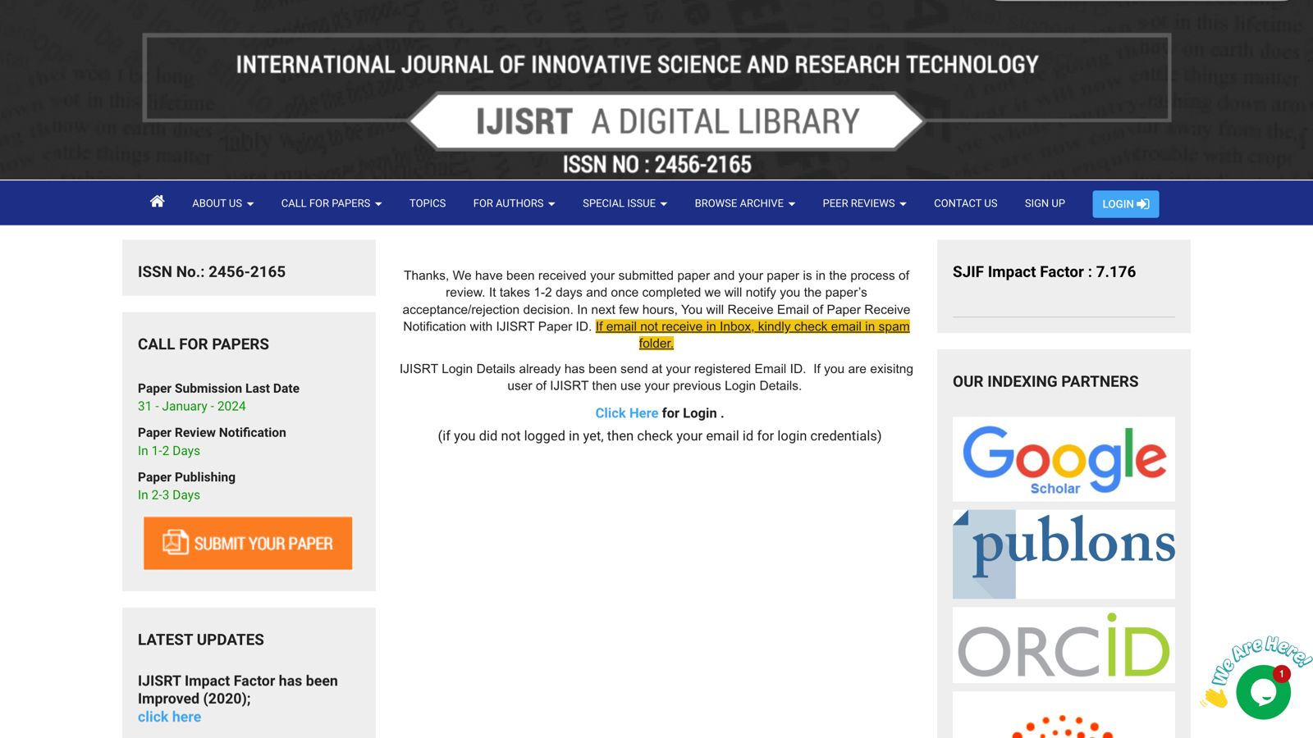
Publication Details

Slide 18

Thank You

